Slide 1
Agentic Logistics Operation — Scoping Pack & POC
Jeven Dale M. Marfil
Github Repository: https://github.com/jevenmarfil/logistics-agent

Slide 2
Problem and Opportunity
Delayed shipments require manual investigation
The disruptions may be caused by multiple elements and need additional information for assessment
If there are multiple shipments, slight delays might be captured unnecessarily and needs to be filtered out for further investigation
Critical scenarios need immediate action
Uncommon scenarios still need human review
Opportunity
Using an AI agent as an assistant can help collect the necessary data faster and also perform initial investigation
Given the available information, this will be a data-driven decision making to be able to have a recommended next steps to take

Slide 3
Product Idea
Shipment
AI Assistant
Assess
Investigate
Recommend
Take Action
Human Review

Slide 4
Scope
Scope
Shipment Assessment
Limitations
Mock shipping Data
Mock weather Data
Nice to Have
Investigation logic
Weather look up
Shipment Data look up
Routes look up
Booking Agent
Live Tracking
Confidence Assessment
Human Review
Recommendation
Multiple LLM option (manual)
Mock routes
No action override (auto-change route or perform action)
Analytics

Slide 5
Agentic Functions
Weather Investigation
  May add traffic and logistics info in the future
Data Investigation
  Database access in the future
Shipment Assessment
  Severity
  Reasoning
  Potential Cause
Recommendation
  Smart routing
Human escalation
  Simulate scenario where human review is needed

Slide 6
POC Architecture Details
Streamlit UI
Langraph Orchestration
LLM Shipment Assessment
Decision Route
Weather Tool
Carrier Route Tool
Recommendation
LLM Evaluation
Human Review
Shipment Input
Define Nodes and Flow
Initial Data look up and decide what tools to use
Gather evidence and data to form recommended action

Slide 7
POC tech used
Python
Langraph
LLM (gemini/open router) for testing
Streamlit (for POC demo)
Future Ideas
Frontend Framework (React/Vue)
Fast API
Docker

Slide 8
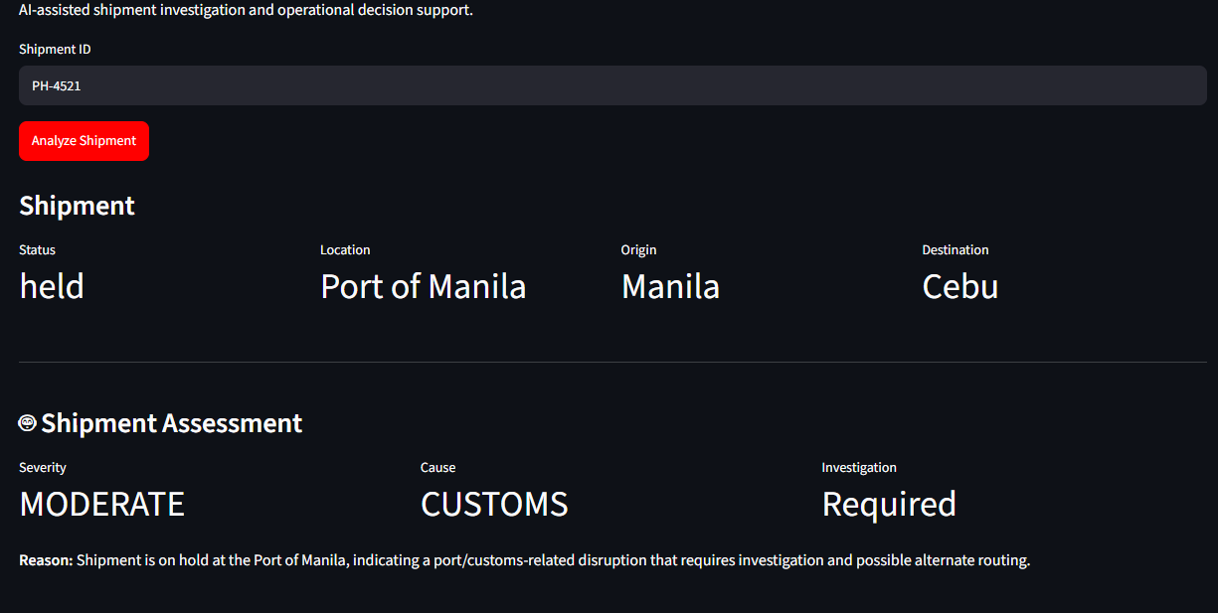
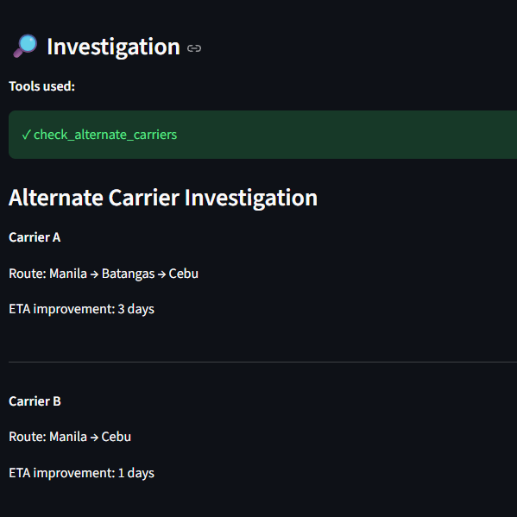
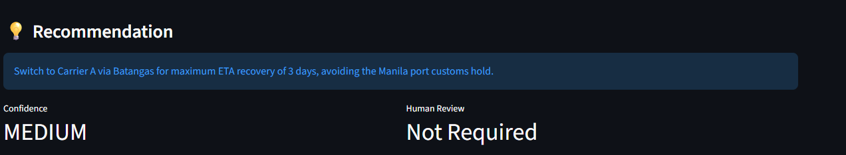
Sample Run

